Slide 1

We care
Blood Donation Management System

Slide 2
GROUP MEMBERS & their contribution
NAME | UID | CONTRIBUTION
Alok Kumar Jha | 20BCS9261 | Php & Database Connectivity
Bhuvanyu Oliyan | 20BCS9245 | Php & Database Connectivity
Saurabh Pandey | 20BCS9269 | HTML, CSS, JavaScript
Shruti Shreya | 20BCS9229 | HTML, CSS, JavaScript

Slide 3
objective
The project Blood Donation Management System is a project that is designed for the blood bank to gather blood from various sources and distribute it to the needy people who have high requirements for it.
The software is designed to handle the daily transactions of the blood bank and search the details when required.
It also helps to register the details of donors.

Slide 4
Limitations of manual system
Time consuming.
Leads to error prone results.
Consumes lot of manpower.
Lacking of donor information.
Uncertainty of Donor availability.
Retrieval of data takes lot of time.
Percentage of accuracy is less

Slide 5
Advantages over manual system
Can be used from anywhere in the world.
Can be accessed anytime.
Quick Search.
Better Communication.
Customize to Volunteer.
Time Optimization.
Cost Optimization.

Slide 6
Features of Blood donation management system
Track and maintain all the Donor Types-Voluntary.
Accurate database/Record Management.
Donor Database-Blood Group wise and Area wise.
Digital Record archival backup and restoring facility-Better Housekeeping and Record Maintenance.
Comprehensive Donor database with Search Facility

Slide 7
Software and language used
HTML
CSS
JavaScript
Php
MySQL
VS Code
XAMPP

Slide 8
Website
Home
About
Services
Gallery
Team
Donate Now
Contact Us
When submitted data stored in database

Slide 9
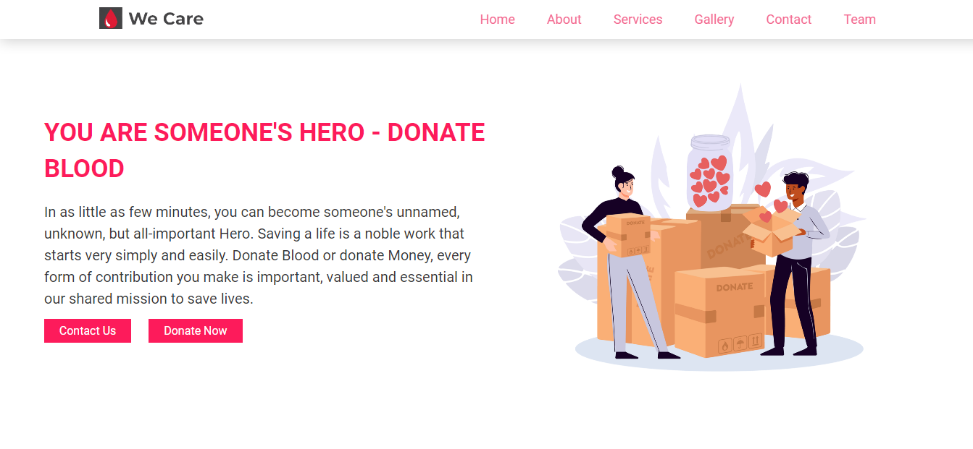
Home page

Slide 10
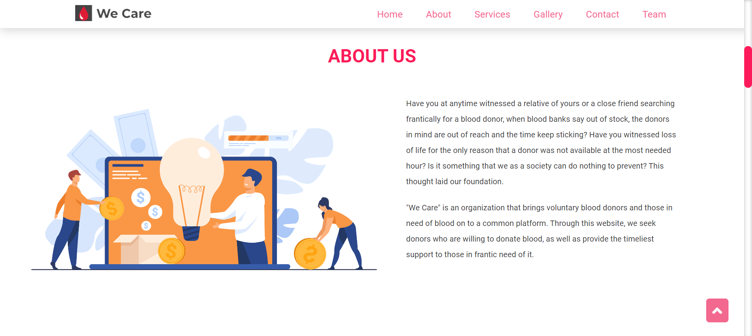
About US

Slide 11
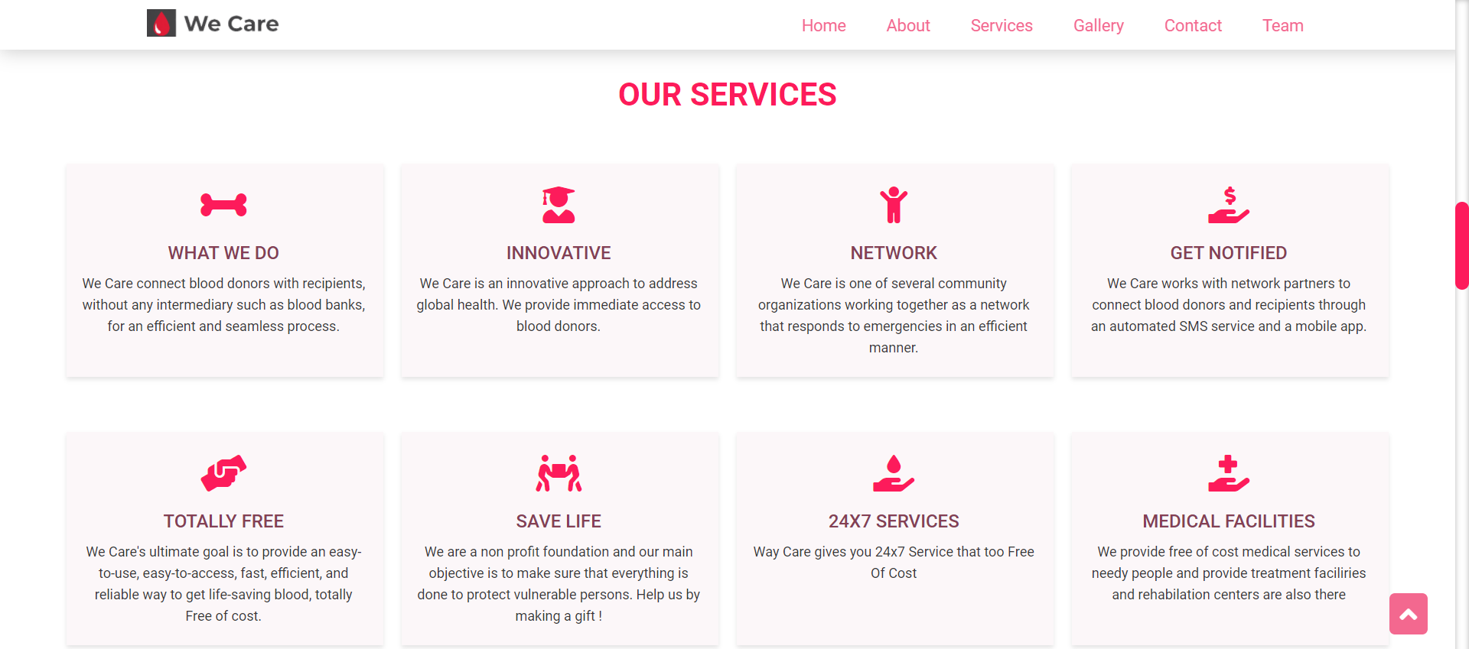
Services

Slide 12
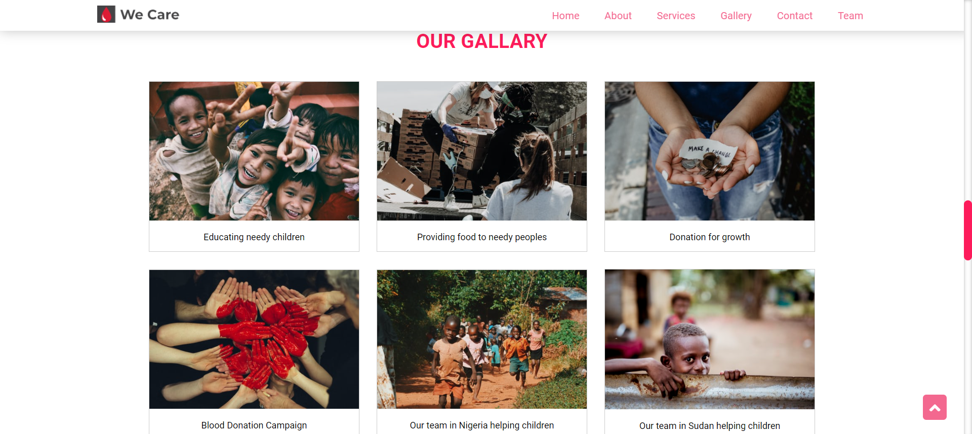
Gallery

Slide 13
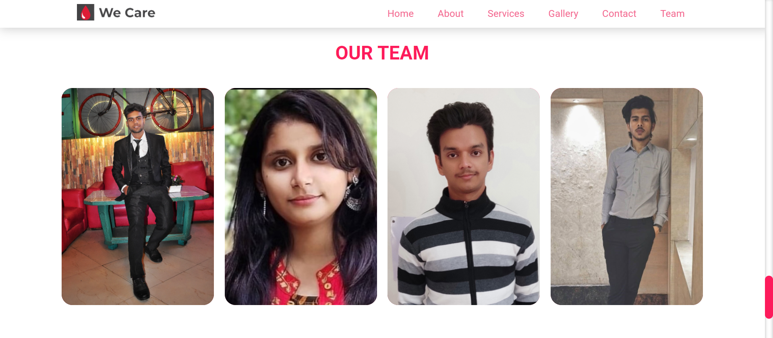
Team

Slide 14
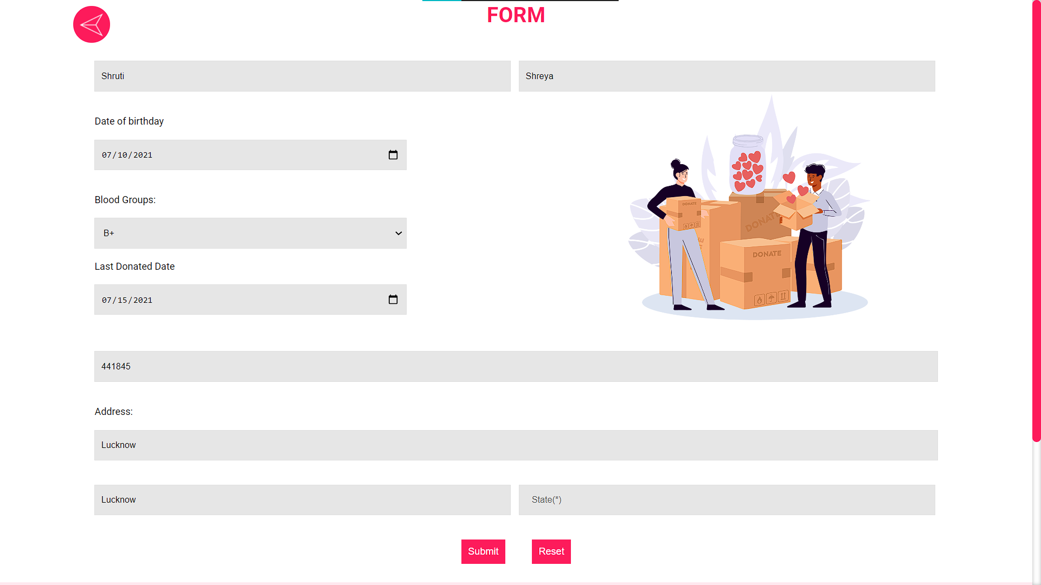
Donate us Form

Slide 15
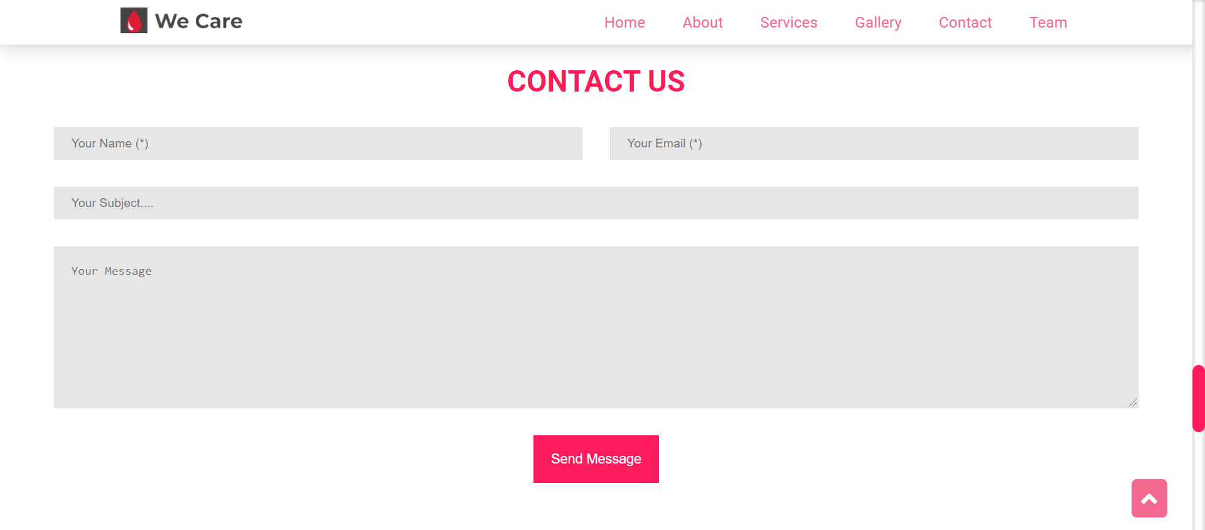
Contact us Form

Slide 16
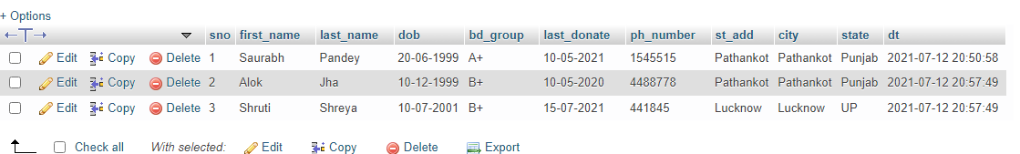
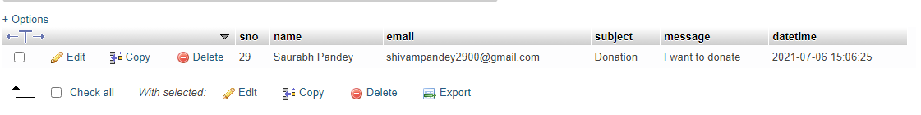
Database entries

Slide 17

Footer
Link to our website :
https://reddevill007.github.io/Blood-Donation-Website/

Slide 18
Future Scope
System can be expanded with availability over worldwide.
Reaching as close as possible of the donor from emergency zone.
A smart phone application of the system can be made.
Providing Donors an option of change his/her availability.
Generating reports on Stocks-Blood Group wise, Area wise and Eligibility wise.

Slide 19


